Slide 1
show SDLC manual deployment

Slide 2
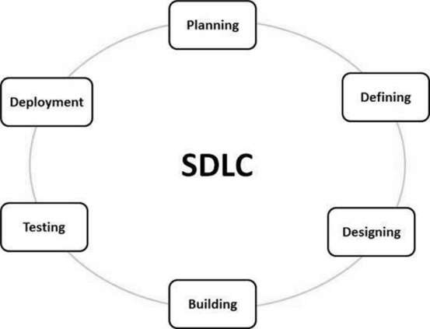
SDLC manual deployment
SDLC or the Software Development Life Cycle is a process that produces software with the highest quality and lowest cost in the shortest time. SDLC includes a detailed plan for how to develop, alter, maintain, and replace a software system
Notes:
It is also called as Software Development Process.
The SDLC aims to produce a high-quality software that meets or exceeds customer expectations, reaches completion within times and cost estimates.
SDLC is a process followed for a software project, within a software organization.

Slide 3
SDLC manual deployment
Stage 1: Planning and Requirement Analysis
Requirement analysis is the most important and fundamental stage in SDLC. It is performed by the senior members of the team with inputs from the customer, the sales department, market surveys and domain experts in the industry. This information is then used to plan the basic project approach and to conduct product feasibility study in the economical, operational and technical areas.
Planning for the quality assurance requirements and identification of the risks associated with the project is also done in the planning stage. The outcome of the technical feasibility study is to define the various technical approaches that can be followed to implement the project successfully with minimum risks.
Notes:
This phase is the main focus of the project managers and stake holders. Meetings with managers, stake holders and users are held in order to determine the requirements like; Who is going to use the system? How will they use the system? What data should be input into the system? What data should be output by the system? These are general questions that get answered during a requirements gathering phase. After requirement gathering these requirements are analyzed for their validity and the possibility of incorporating the requirements in the system to be development is also studied.

Slide 4
SDLC manual deployment
Stage 2: Defining Requirements
Once the requirement analysis is done the next step is to clearly define and document the product requirements and get them approved from the customer or the market analysts. This is done through an SRS (Software Requirement Specification) document which consists of all the product requirements to be designed and developed during the project life cycle.

Slide 5
SDLC manual deployment
Stage 3: Designing the Product Architecture
SRS is the reference for product architects to come out with the best architecture for the product to be developed. Based on the requirements specified in SRS, usually more than one design approach for the product architecture is proposed and documented in a DDS - Design Document Specification.
This DDS is reviewed by all the important stakeholders and based on various parameters as risk assessment, product robustness, design modularity, budget and time constraints, the best design approach is selected for the product.
A design approach clearly defines all the architectural modules of the product along with its communication and data flow representation with the external and third party modules (if any). The internal design of all the modules of the proposed architecture should be clearly defined with the minutest of the details in DDS
Notes:
System Design helps in specifying hardware and system requirements and also helps in defining overall system architecture. The system design specifications serve as input for the next phase of the model.

Slide 6
SDLC manual deployment
Stage 4: Building or Developing the Product
In this stage of SDLC the actual development starts and the product is built. The programming code is generated as per DDS during this stage. If the design is performed in a detailed and organized manner, code generation can be accomplished without much hassle.
Developers must follow the coding guidelines defined by their organization and programming tools like compilers, interpreters, debuggers, etc. are used to generate the code. Different high level programming languages such as C, C++, Pascal, Java and PHP are used for coding. The programming language is chosen with respect to the type of software being developed
Notes:
On receiving system design documents, the work is divided in modules/units and actual coding is started. Since, in this phase the code is produced so it is the main focus for the developer. This is the longest phase of the software development life cycle.

Slide 7
SDLC manual deployment
Stage 5: Testing the Product
This stage is usually a subset of all the stages as in the modern SDLC models, the testing activities are mostly involved in all the stages of SDLC. However, this stage refers to the testing only stage of the product where product defects are reported, tracked, fixed and retested, until the product reaches the quality standards defined in the SRS.
Notes:
After the code is developed it is tested against the requirements to make sure that the product is actually solving the needs addressed and gathered during the requirements phase. During this phase all types of functional testing like unit testing, integration testing, system testing, acceptance testing are done as well as non-functional testing are also done.

Slide 8
SDLC manual deployment
Stage 6: Deployment in the Market and Maintenance
Once the product is tested and ready to be deployed it is released formally in the appropriate market. Sometimes product deployment happens in stages as per the business strategy of that organization. The product may first be released in a limited segment and tested in the real business environment (UAT- User acceptance testing).
Then based on the feedback, the product may be released as it is or with suggested enhancements in the targeting market segment. After the product is released in the market, its maintenance is done for the existing customer base.
Notes:
After successful testing the product is delivered / deployed to the customer for their use.
As soon as the product is given to the customers they will first do the beta testing. If any changes are required or if any bugs are caught, then they will report it to the engineering team. Once those changes are made or the bugs are fixed then the final deployment will happen.
Once when the customers starts using the developed system then the actual problems comes up and needs to be solved from time to time. This process where the care is taken for the developed product is known as maintenance.

Slide 9
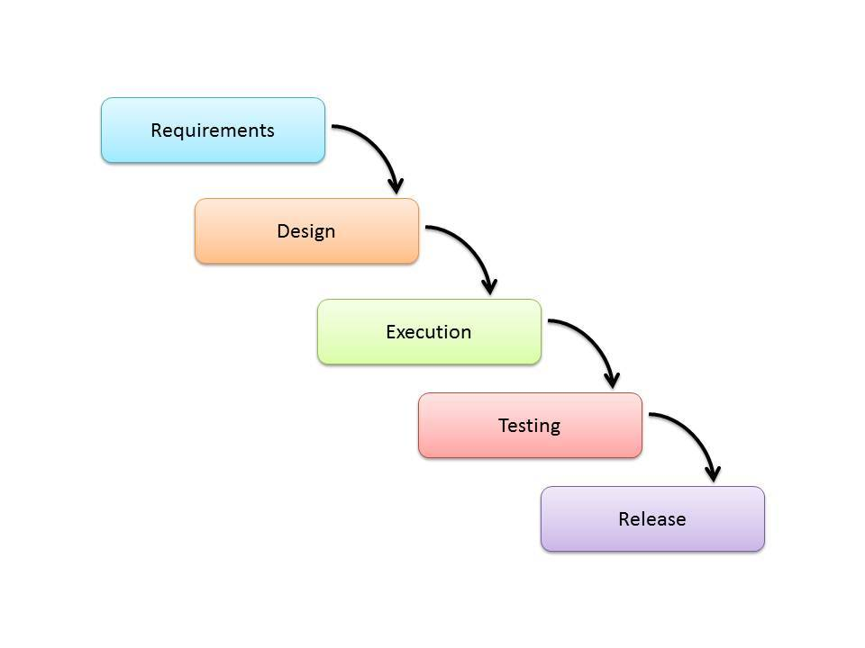
OTHER SDLC MODELS
Waterfalls Model
The Waterfall Model is a linear sequential flow. In which progress is seen as flowing steadily downwards (like a waterfall) through the phases of software implementation. This means that any phase in the development process begins only if the previous phase is complete. The waterfall approach does not define the process to go back to the previous phase to handle changes in requirement. The waterfall approach is the earliest approach and most widely known that was used for software development.
Notes:
It is also referred to as a linear-sequential life cycle model.
It is very simple to understand and use.
In a waterfall model, each phase must be completed before the next phase can begin and there is no overlapping in the phases.

Slide 10
Waterfalls Model
ADVANTAGES
Simple and easy to understand and use
Phases are processed and completed one at a time.
Works well for smaller projects where requirements are very well understood.
Process and results are well documented.
DISADVANTAGES
No working software is produced until late during the life cycle.
Not suitable for the projects where requirements are at a moderate to high risk of changing.
High amounts of risk and uncertainty.
Poor model for long and ongoing projects.

Slide 11
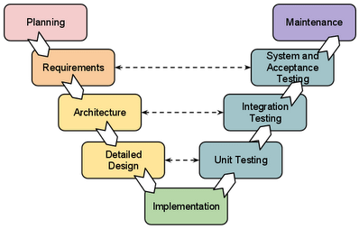
OTHER SDLC MODELS
V-Shaped Model
It is an extension of the waterfall model, Instead of moving down in a linear way, the process steps are bent upwards after the implementation and coding phase, to form the typical V shape. The major difference between V-shaped model and waterfall model is the early test planning in the V-shaped model.
Notes:
The V-model is an SDLC model where execution of processes happens in a sequential manner in a V-shape. It is also known as Verification and Validation model.

Slide 12
V-sHAPED Model
ADVANTAGES
This is a highly-disciplined model and Phases are completed one at a time.
Works well for smaller projects where requirements are very well understood.
Easy to manage due to the rigidity of the model. Each phase has specific deliverables and a review process
DISADVANTAGES
Not a good model for complex and object-oriented projects.
Not suitable for the projects where requirements are at a moderate to high risk of changing
Once an application is in the testing stage, it is difficult to go back and change a functionality.

Slide 13
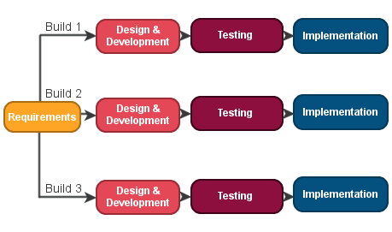
OTHER SDLC MODELS
Iterative Model
Iterative Model is a part of Software Development Life Cycle. It is a particular implementation of a software development life cycle that focuses on an initial, simplified implementation, which then progressively gains more complexity and a broader feature set until the final system is complete.
Notes:
An iterative life cycle model does not attempt to start with a full specification of requirements. Instead, development begins by specifying and implementing just part of the software, which is then reviewed to identify further requirements. This process is then repeated, producing a new version of the software at the end of each iteration of the model.
Iterative process starts with a simple implementation of a subset of the software requirements and iteratively enhances the evolving versions until the full system is implemented. At each iteration, design modifications are made and new functional capabilities are added. The basic idea behind this method is to develop a system through repeated cycles (iterative) and in smaller portions at a time (incremental).

Slide 14
ITErative Model
ADVANTAGES
Some working functionality can be developed quickly and early in the life cycle.
Better suited for large and mission-critical projects.
It supports changing requirements.
DISADVANTAGES
More resources may be required.
More management attention is required
Not suitable for smaller projects.

Slide 15
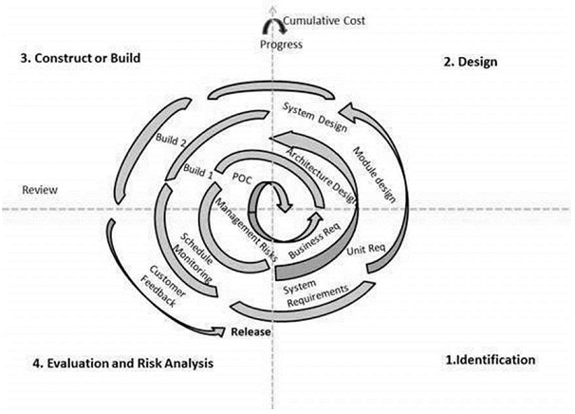
OTHER SDLC MODELS
Spiral Model
It is combining elements of both design and prototyping-in-stages, in an effort to combine advantages of top-down and bottom-up concepts. This model of development combines the features of the prototyping model and the waterfall model. The spiral model is favored for large, expensive, and complicated projects. This model uses many of the same phases as the waterfall model, in essentially the same order, separated by planning, risk assessment, and the building of prototypes and simulations.
Notes:
Identification
This phase starts with gathering the business requirements in the baseline spiral. In the subsequent spirals as the product matures, identification of system requirements, subsystem requirements and unit requirements are all done in this phase.
This phase also includes understanding the system requirements by continuous communication between the customer and the system analyst. At the end of the spiral, the product is deployed in the identified market.
Design
The Design phase starts with the conceptual design in the baseline spiral and involves architectural design, logical design of modules, physical product design and the final design in the subsequent spirals.
Construct or Build
The Construct phase refers to production of the actual software product at every spiral. In the baseline spiral, when the product is just thought of and the design is being developed a POC (Proof of Concept) is developed in this phase to get customer feedback.
Then in the subsequent spirals with higher clarity on requirements and design details a working model of the software called build is produced with a version number. These builds are sent to the customer for feedback.
Evaluation and Risk Analysis
Risk Analysis includes identifying, estimating and monitoring the technical feasibility and management risks, such as schedule slippage and cost overrun. After testing the build, at the end of first iteration, the customer evaluates the software and provides feedback.

Slide 16
spiral Model
ADVANTAGES
Changing requirements can be accommodated.
Users see the system early.
Development can be divided into smaller parts and the risky parts can be developed earlier which helps in better risk management.
DISADVANTAGES
Not suitable for small or low risk projects and could be expensive for small projects.
End of the project may not be known early.

